Slide 1
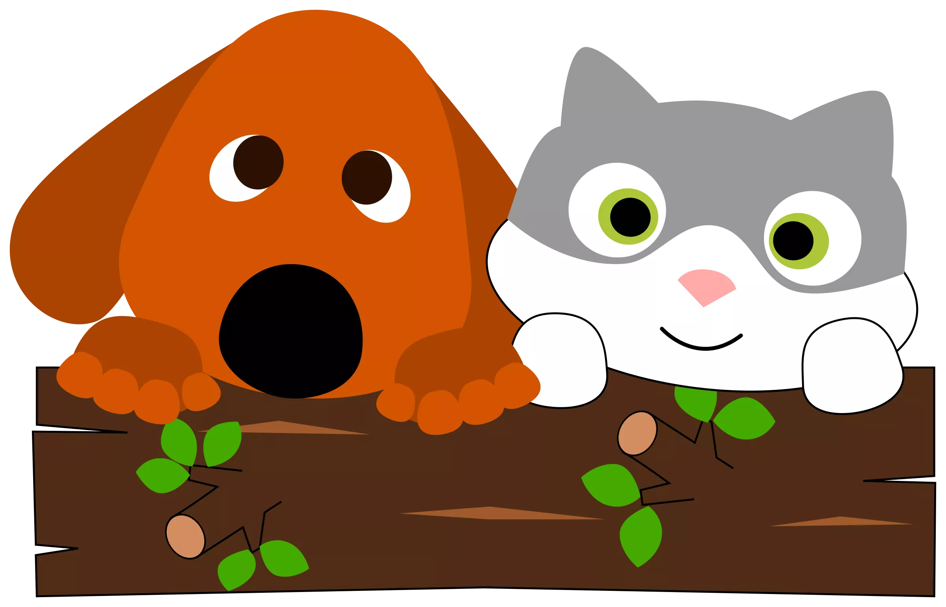
Coding with App Inventor
STEAM Camp Athens 2019

Slide 2
Go to this link to access this presentation!
http://tinyurl.com/y3ybuygr

Slide 3
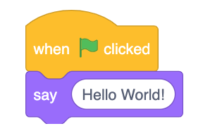
App Inventor
App Inventor lets you easily build apps using block-based programming!
Instead of writing
if flag_green is clicked:
print “Hello World!”
We can drag logic blocks that perform the desired actions such as

Slide 4
Goal: Building a Custom App
The presentation has an outline of how to make a simple voting app, but feel free to make whatever kind of app you wish!

Slide 5
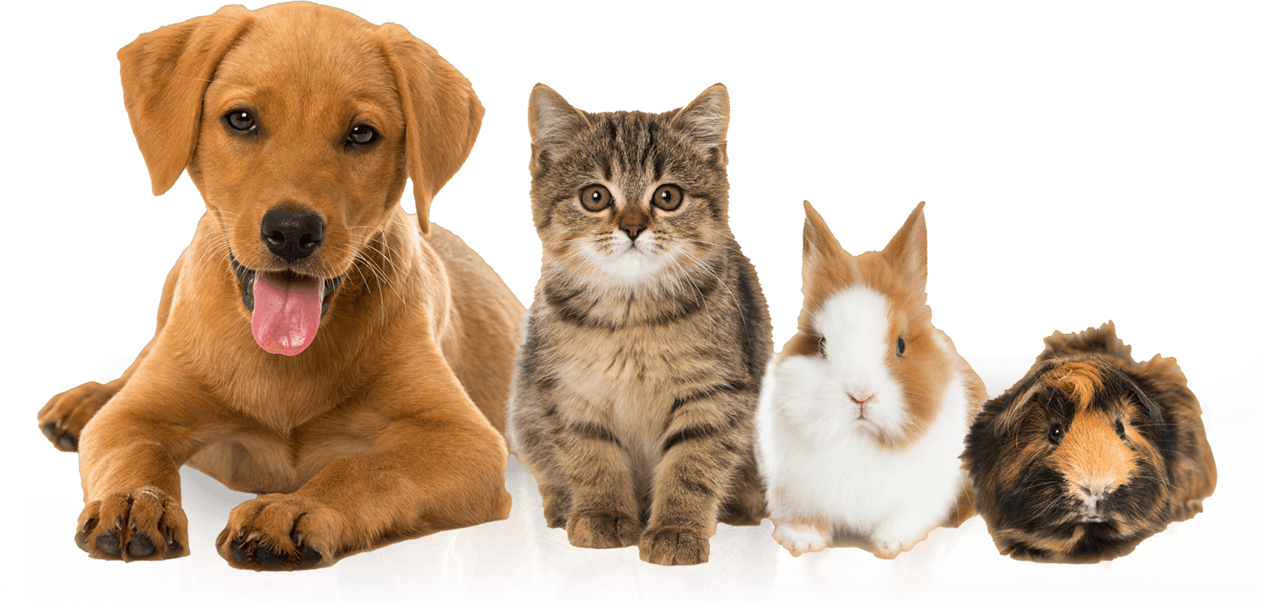
App Inventor Intro: HelloWoofPurr
A voting app where users will vote between a cat versus a dog

Slide 6
Creating a Project
Start a new project in App Inventor and name it HelloWoofPurr.

Slide 7
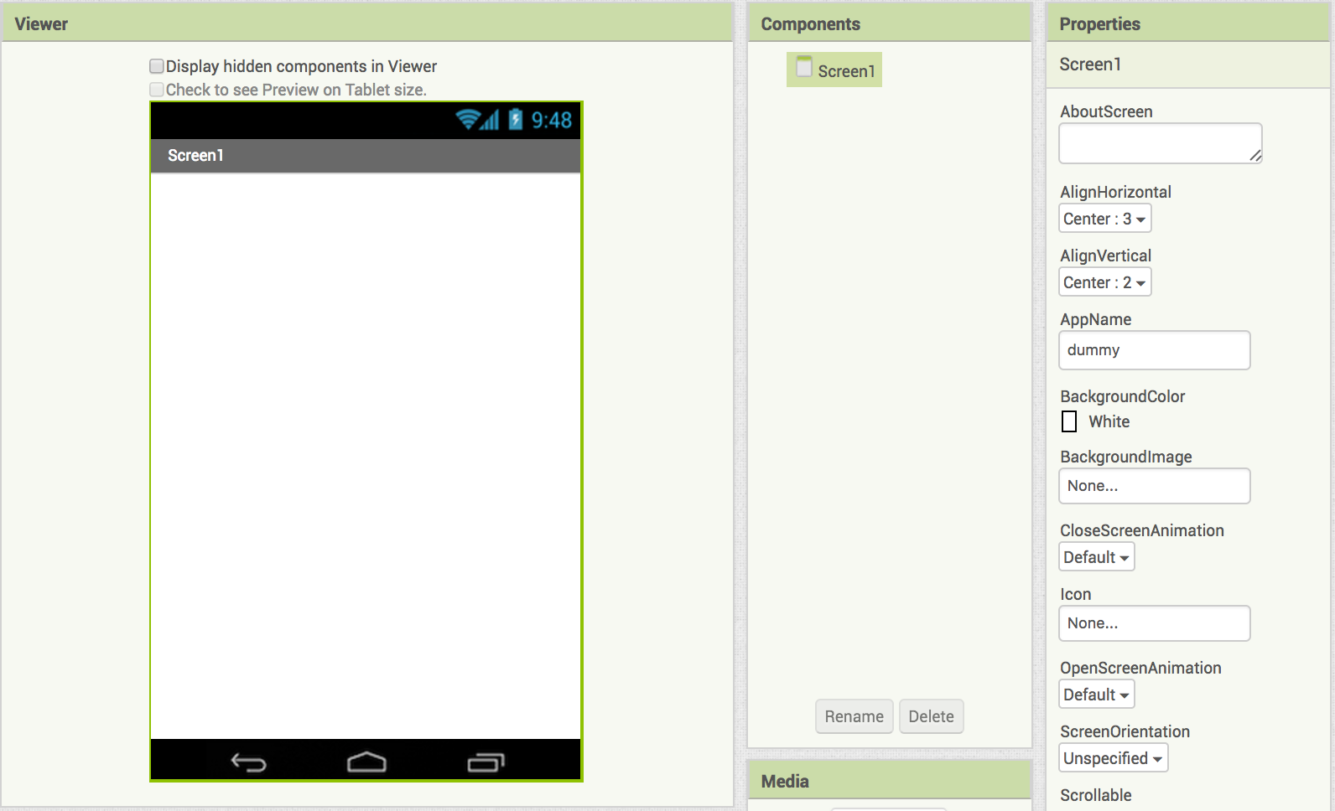
Centering Content
Click on Screen one and set:
AlignHorizontal to Center: 3
AlignVertical to Center: 2

Slide 8
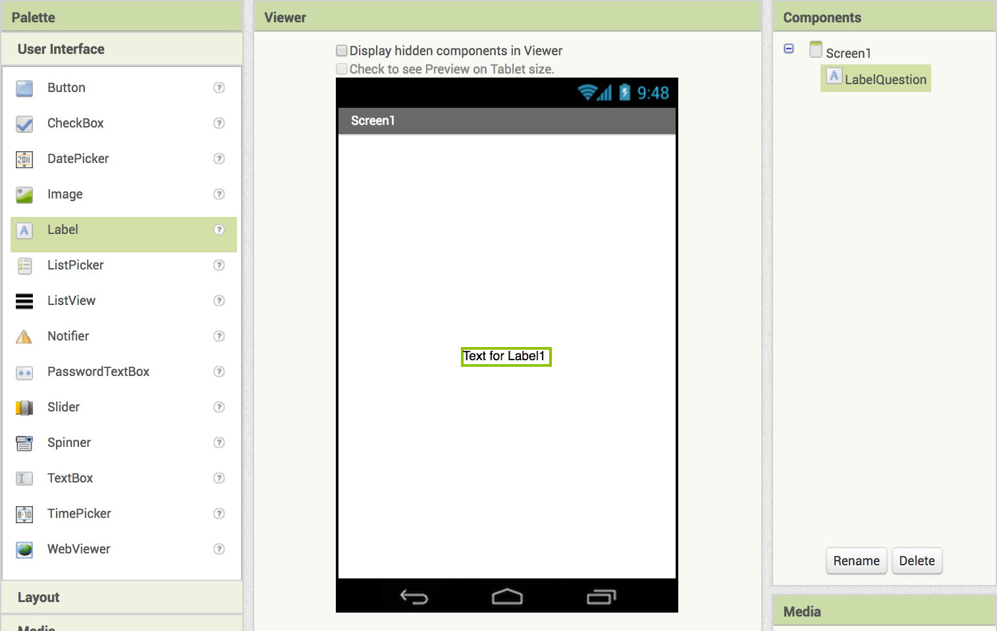
Adding Text Boxes
Drag a label to the screen and rename it LabelQuestion
You can replace the text using the rightmost Properties column and editing what is under “Text”

Slide 9
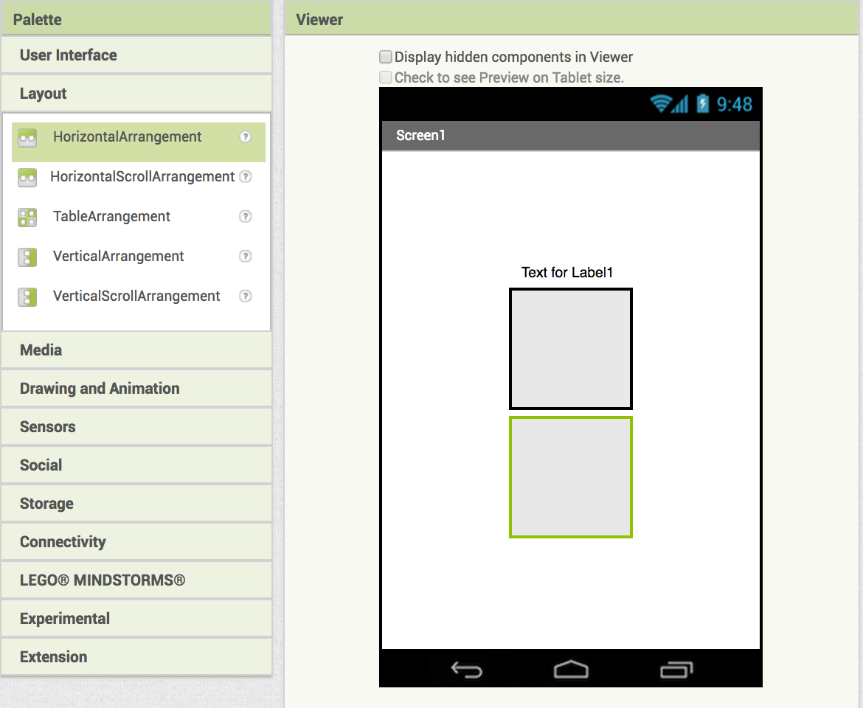
Drag in two HorizontalArrangements

Slide 10
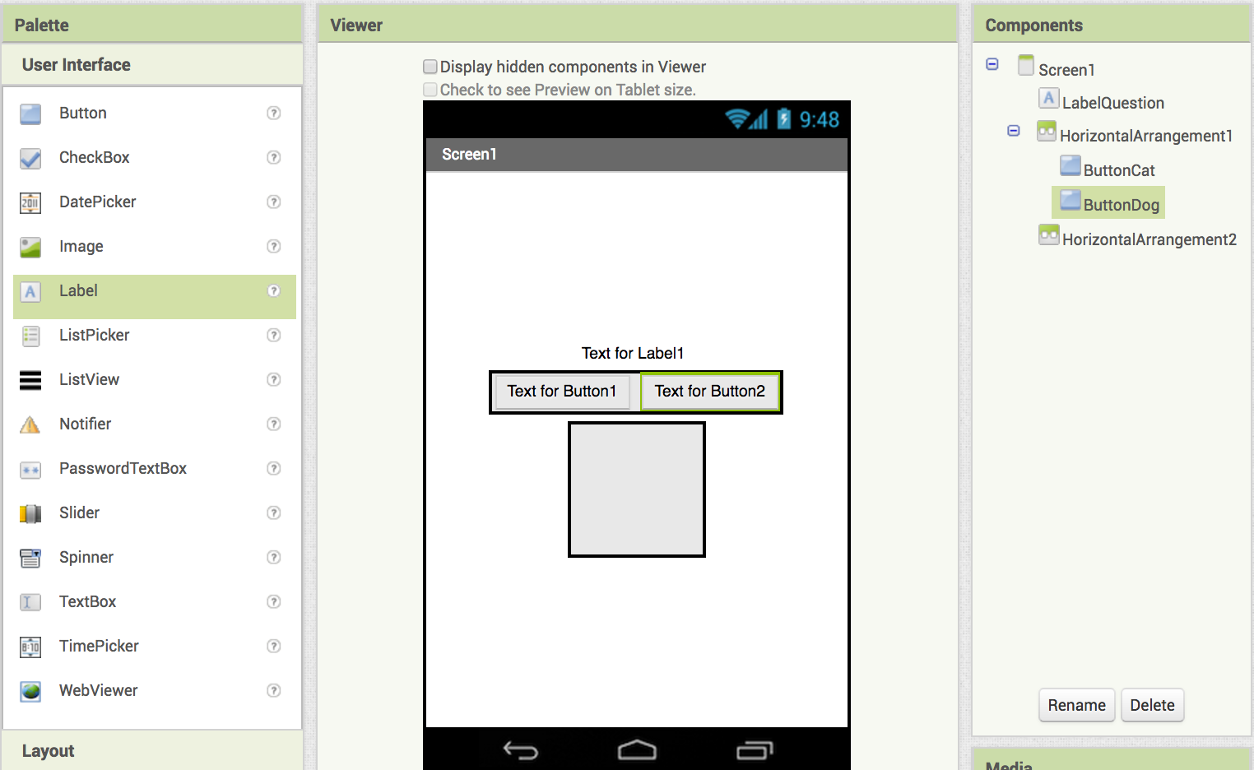
In the top HorizontalArrangement add button and rename it ButtonCat
Add a second button to the right of it and rename it ButtonDog

Slide 11
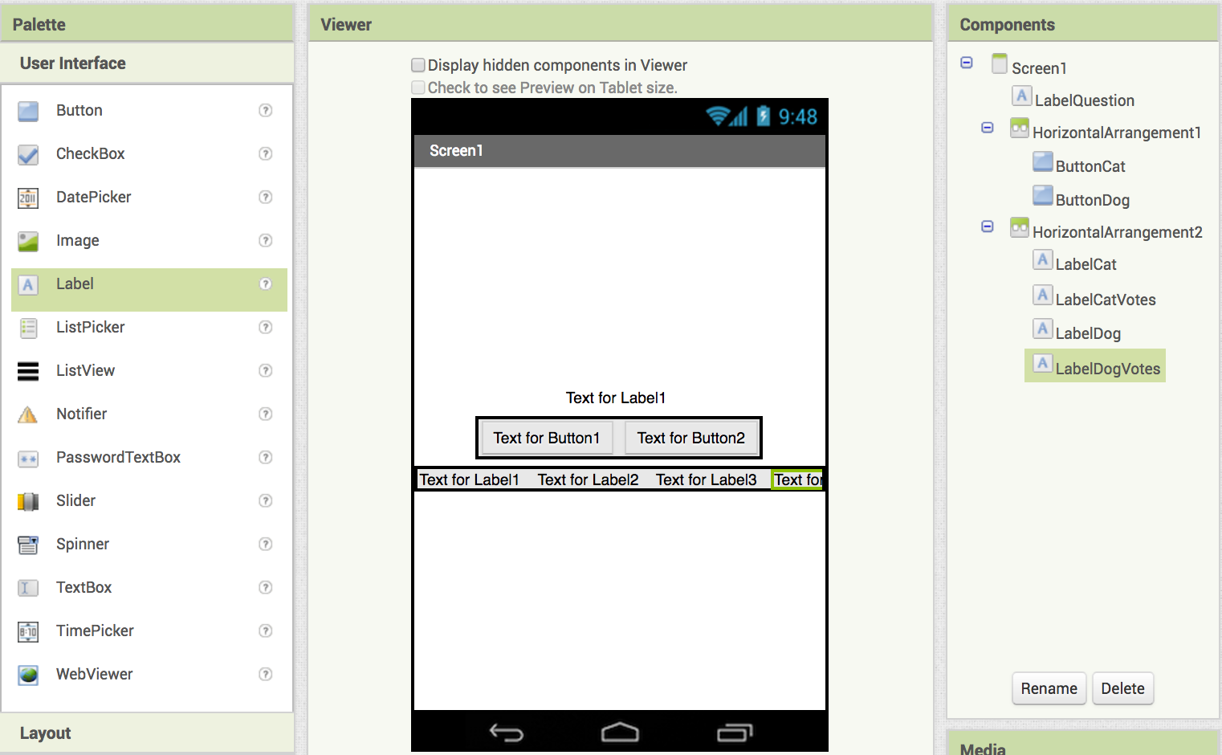
Set the bottom HorizontalArrangement width to FillParent
Add 4 labels and rename them:
LabelCat
LabelCatVotes
LabelDog
LabelDogVotes

Slide 12
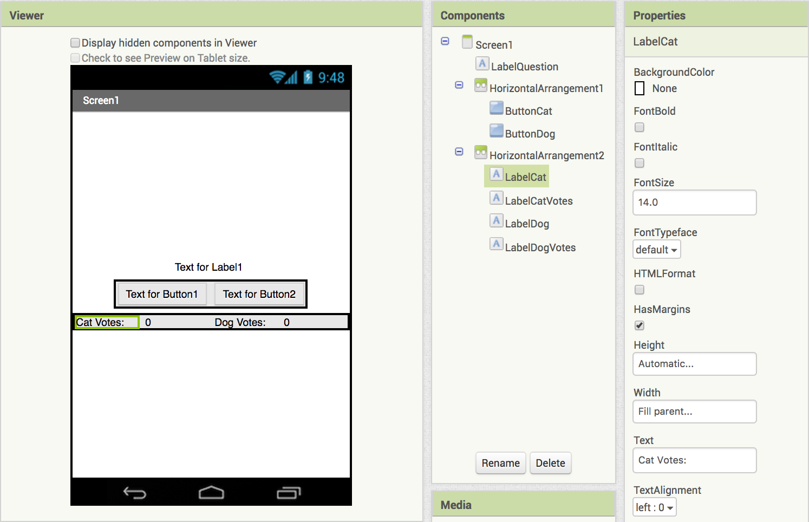
Set LabelCat width to FillParent
Change the Text to "Cat Votes: "
Set LabelCatVotes width to FillParent
Change the Text to "0"
Set LabelDog width to FillParent
Change the Text to "Dog Votes: "
Set LabelDogVotes width to FillParent
Change the Text to "0"

Slide 13
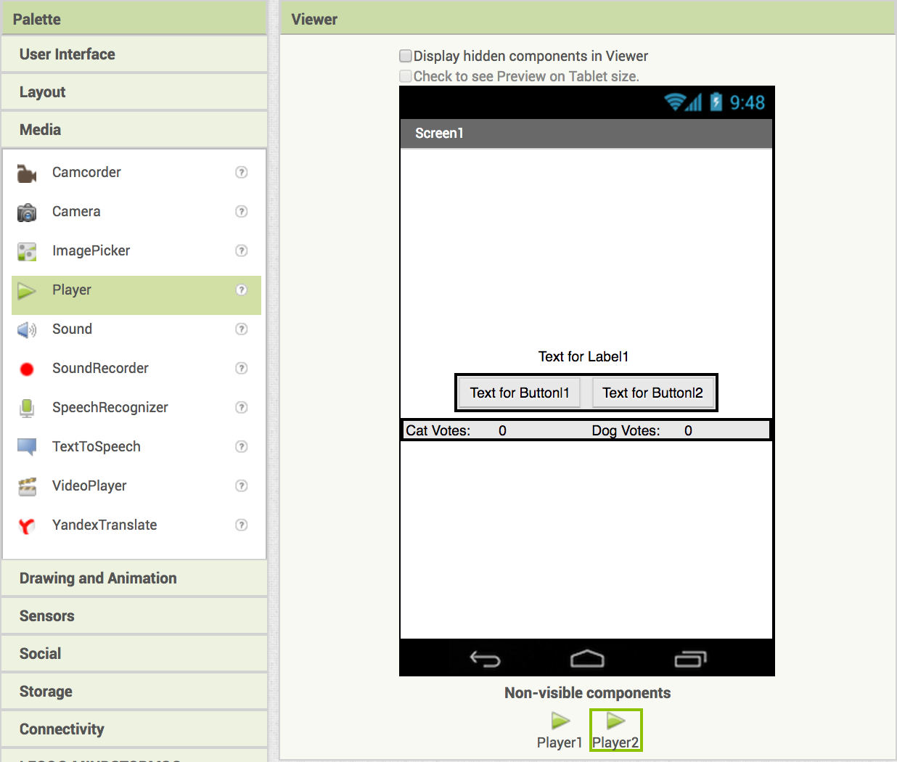
Now we need to set up our app to play sounds.
Drag in 2 Player components from the Media drawer
After you drag in the Players, they will appear here.

Slide 14
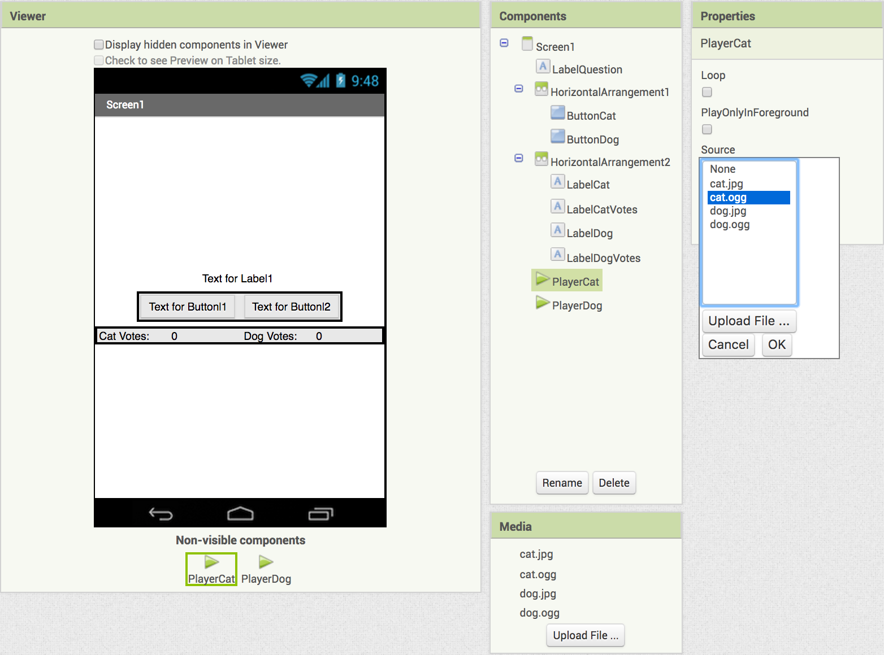
Let's set the sounds for the Players!
Find sounds for both animals, be sure they are .ogg files
First, rename Player1 to PlayerCat.
In the Properties panel click on Source
Choose cat.ogg
Next, rename Player2 to PlayerDog.
In the Properties panel click on Source
Choose dog.ogg
Notes:
https://commons.wikimedia.org/wiki/File:Meow.ogg

Slide 15
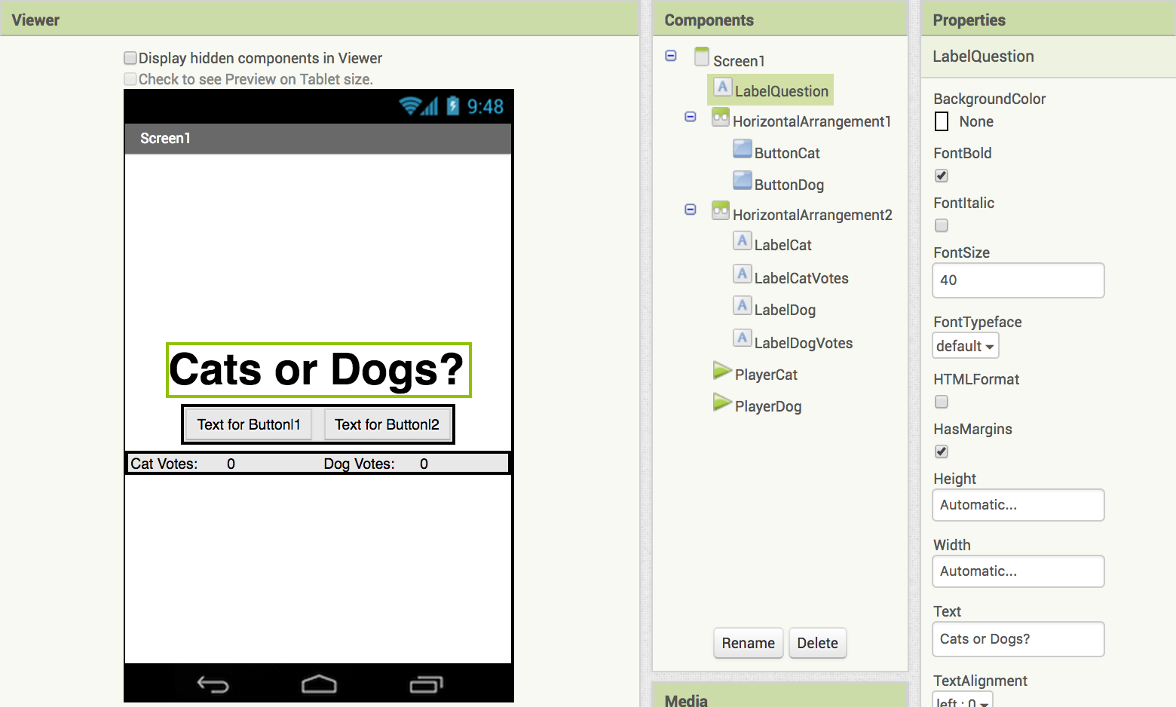
Let's update the LabelQuestion!
Select
Set to 40
Your LabelQuestion should now look like this.
Change text to:
Cats or Dogs?

Slide 16
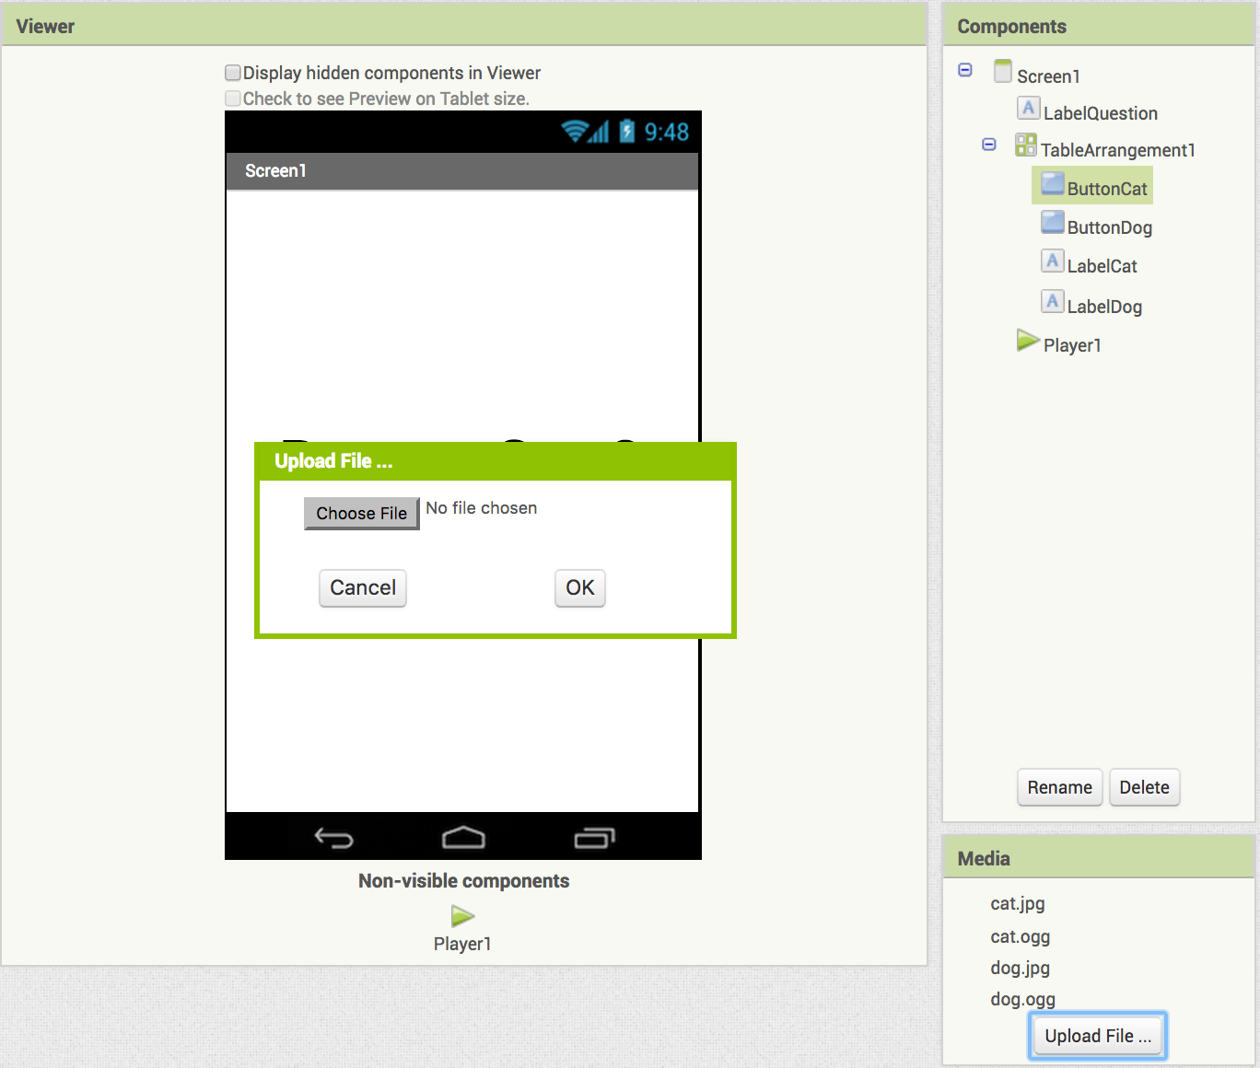
Upload the pictures and sounds for our app.
Download each of these files to your computer:
cat.jpg (our cat image)
cat.ogg (our cat sound)
dog.jpg (our dog image)
dog.ogg (our dog sound)
Your uploaded files should appear below
Under media, click on Upload File… then Choose File, find the images and sounds and upload them to your computer.

Slide 17
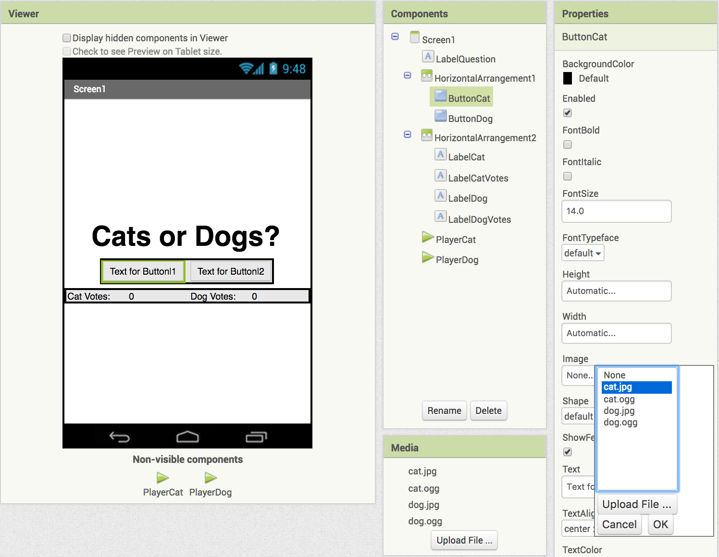
Set the pictures for ButtonCat and ButtonDog.
Under the Properties for ButtonCat click Image
choose cat.jpg

Slide 18
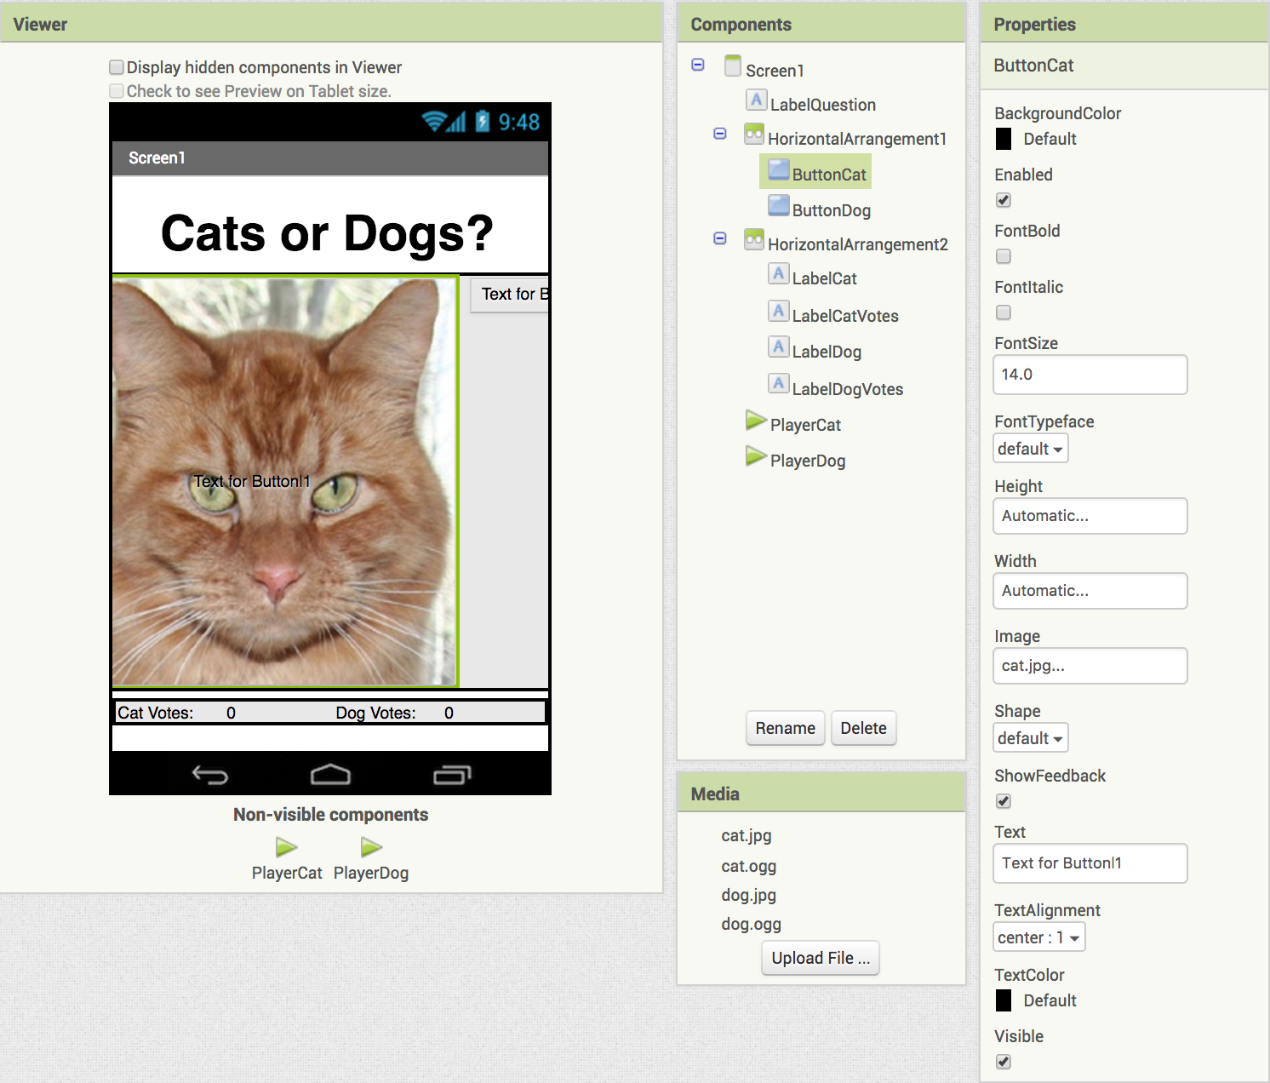
Your screen should look like this.
Let's fix the cat so it fits the screen!

Slide 19
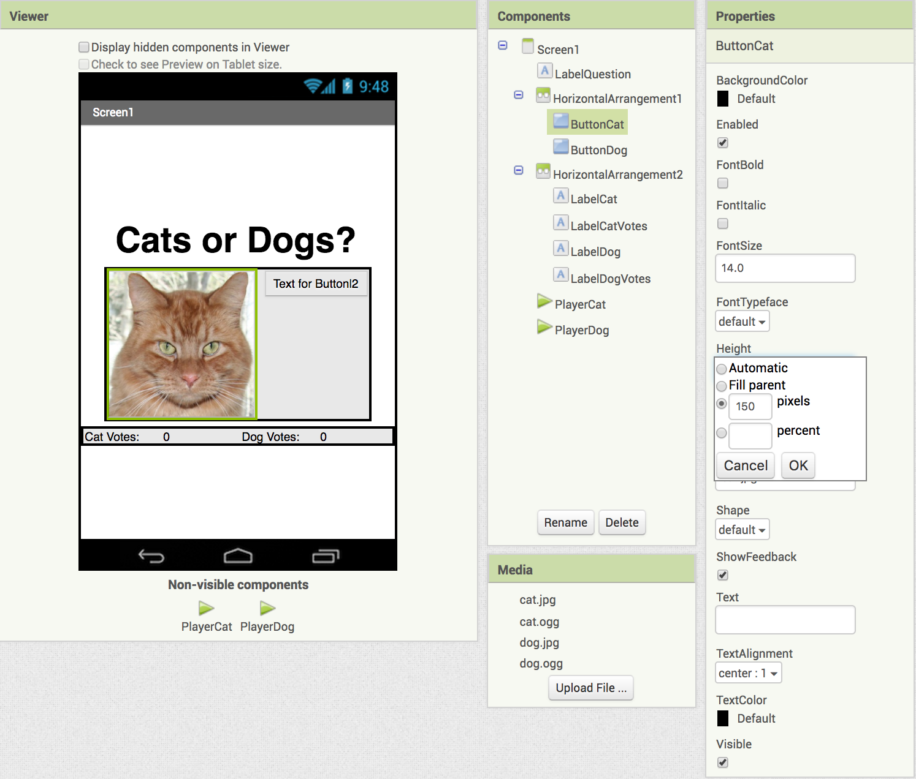
Set the image's height and width.
Under Properties, click on Height - set it to 150 pixels
Do the same for Width
Erase the words under Text
Your ButtonCat should now look like this.

Slide 20
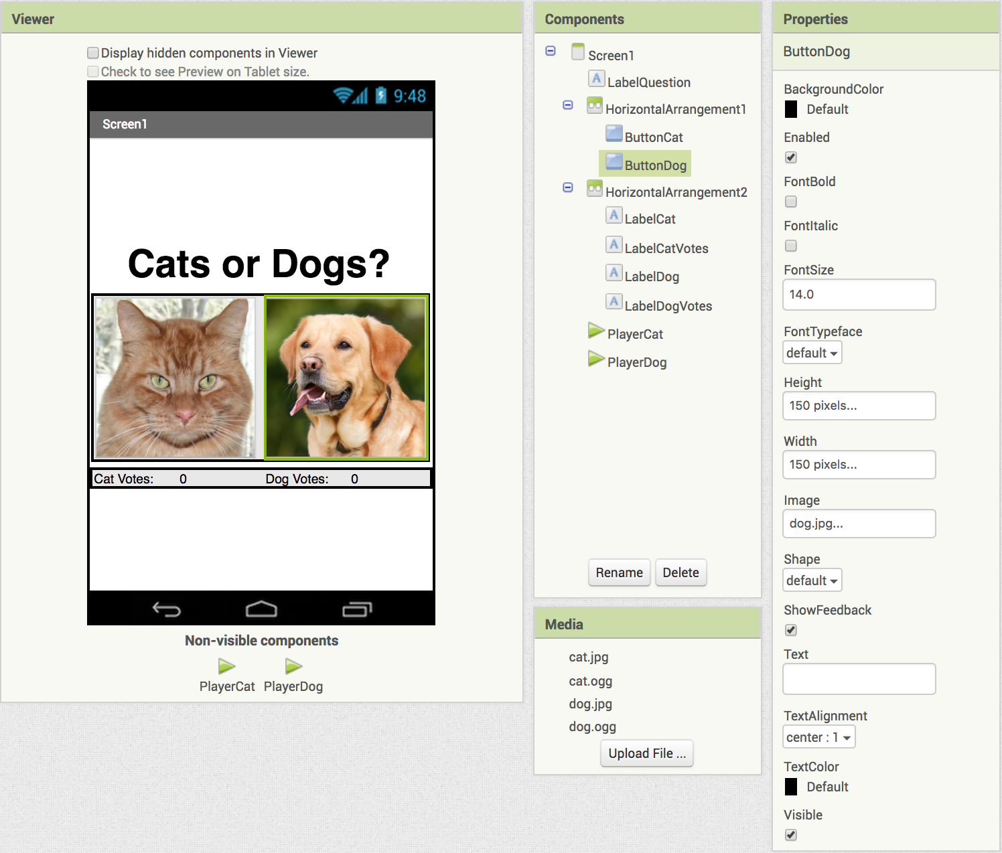
Repeat the steps for ButtonDog.
Select the dog.jpg Image
Set the Height and Width to 150 pixels
Erase the words under Text
Your screen should now look like this.

Slide 21
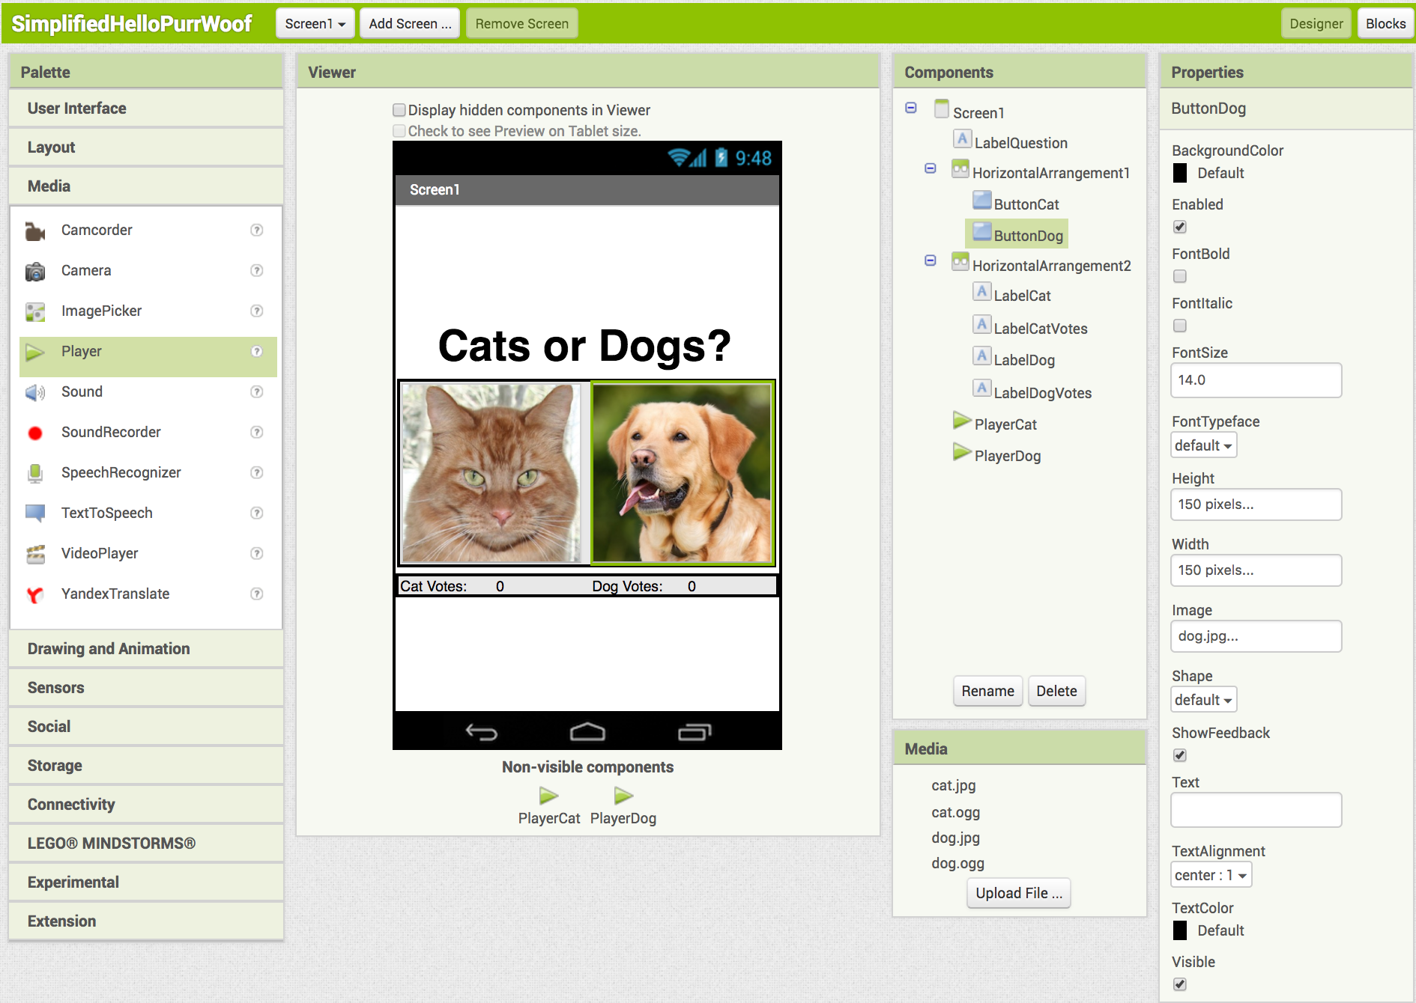
It’s time to code our app! Switch to the Blocks window (top right corner).

Slide 22
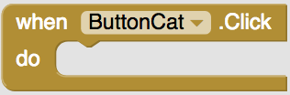
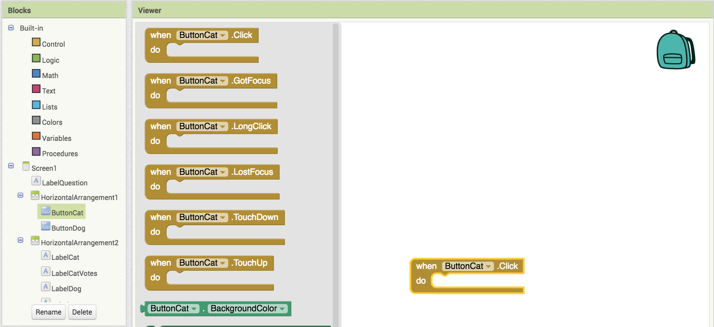
Programming the vote buttons.
Click on ButtonCat
Drag out
this triggers an action when someone presses ButtonCat

Slide 23

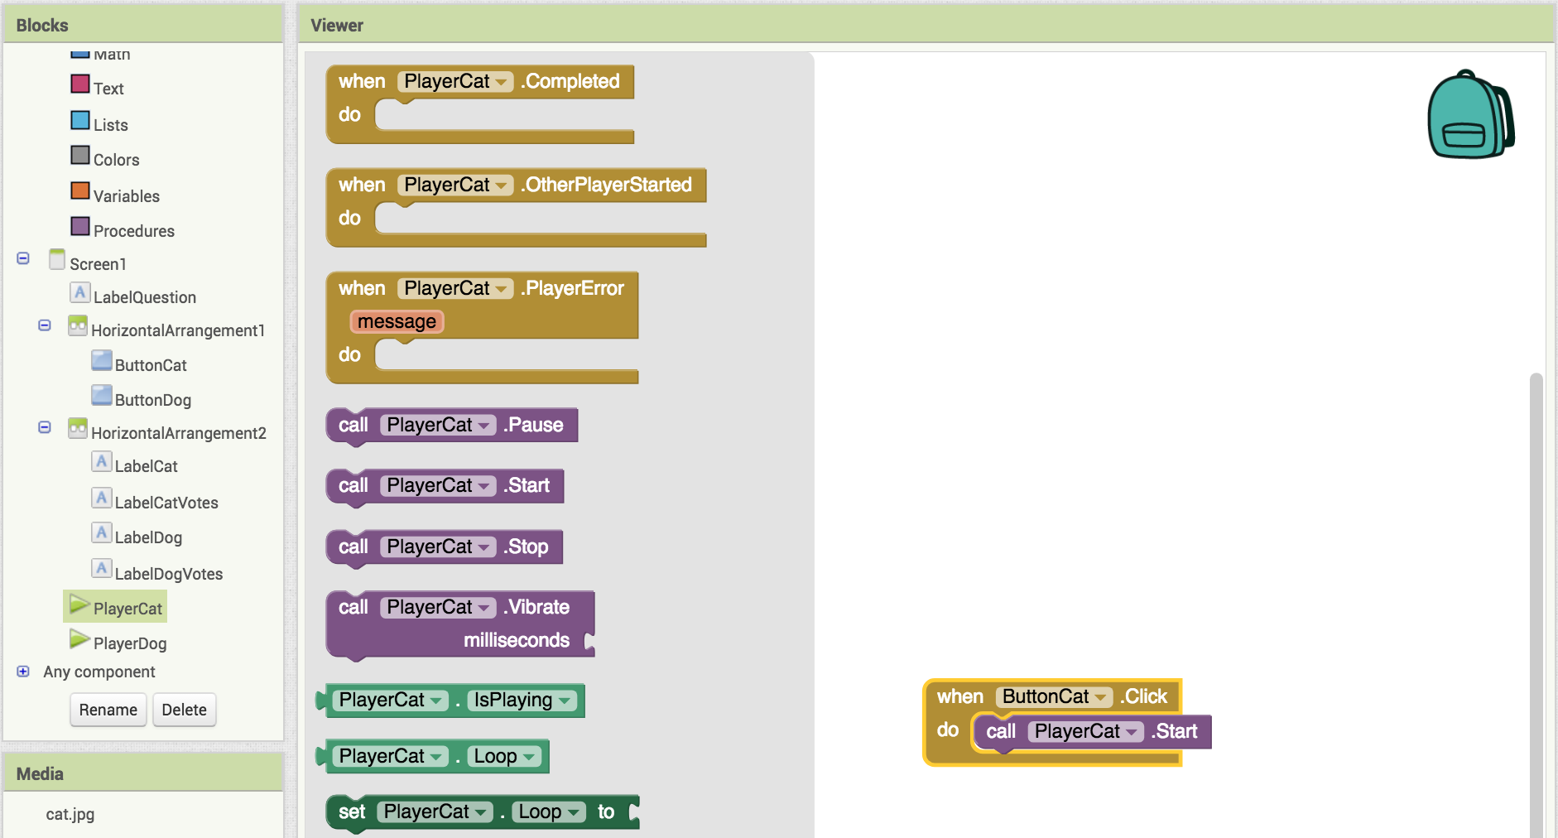
Making a sound play.
Click on PlayerCat.
Drag out and add it to
this makes the player play the sound

Slide 24

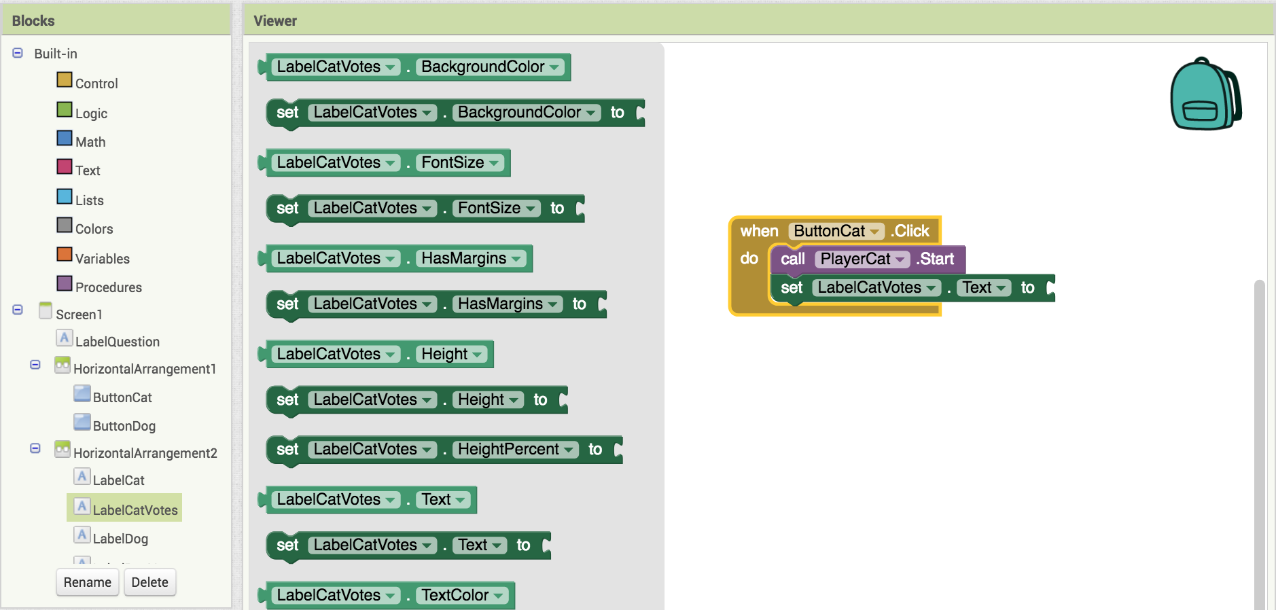
Adding the votes.
Click on LabelCatVotes.
Drag out add it to

Slide 25


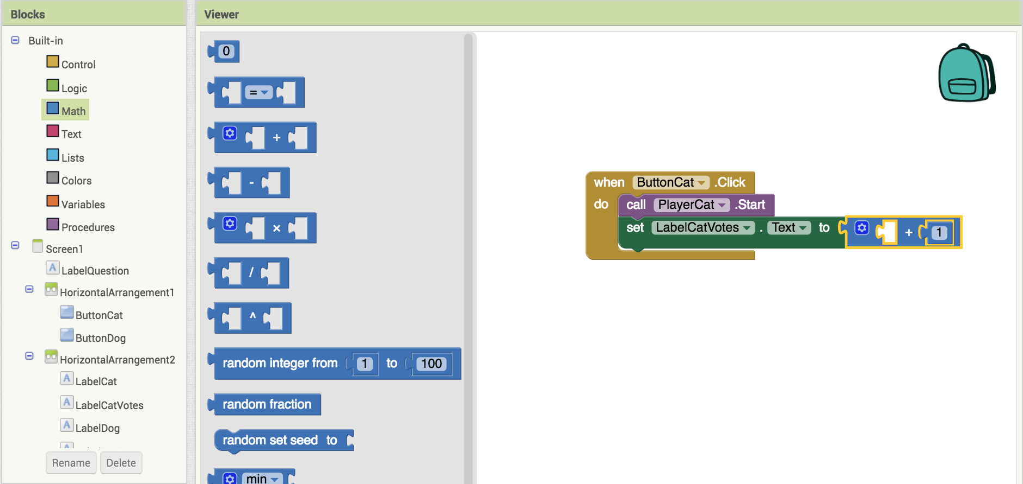
Adding the votes.
Click on Math.
Drag out and and add them to
Click on and change its value to 1

Slide 26


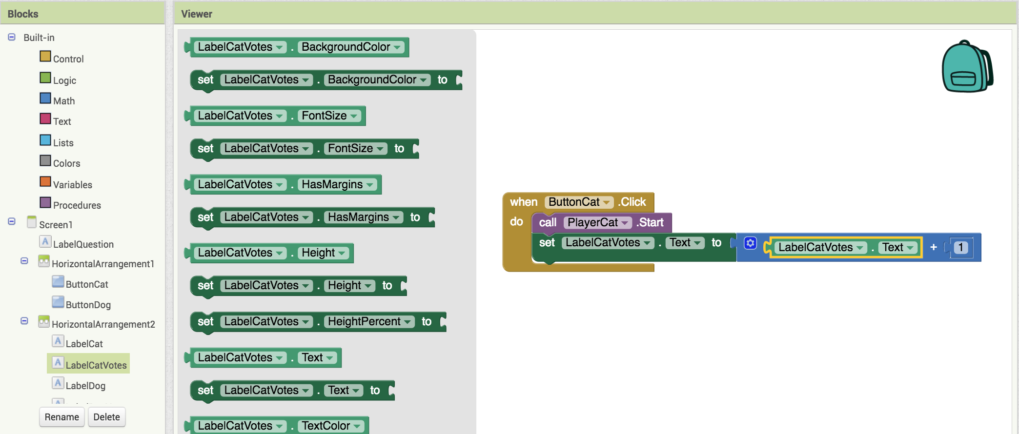
Adding the votes.
Click on LabelCatVotes.
Drag out and add it to
Now test it out and see if the cat meows and the votes change!

Slide 27

Complete the code for Dogs!
Do the same things you did for the
for
When you're done test it out and collect votes from your friends!

Slide 28
Challenge Yourself!
Try adding a “reset” button that changes all the votes back to zero.
Try adding a new screen that keeps track of the names of people who voted.
Hint: You will have to also edit Screen 1 so that users can enter their names.

Slide 29
Further Exploration Questions
What are some other ways we could increment CatVote and DogVote?
Could we use one player instead of two players to play the sounds? What else in the code would have to change if we used two players?
Is there anything to stop someone from voting 20 times?
Change the app to be about something else other than voting on cats or dogs. What else could an app like this be used for?

